Slide 1
L01.01 Complexity, Asymptotic notation
50.004 Introduction to Algorithm
Dr. Simon LUI
ISTD, SUTD

Slide 2
Basic definitions
What is a Computational problem:
Map an input (e.g. x) to an output (e.g. f(x))
Notes:
F: function, not implementation

Slide 3
Basic definitions
e.g. let say, f(x) = shortest distance from Orchard to x, then
If x = “Expo”, f(x) = shortest distance from Orchard to Expo
If x = “Changi”, f(x) = shortest distance from Orchard to Changi
So, given x, we want to COMPUTE f(x)
A good algorithm can compute f(x) quickly
Notes:
F: function, not implementation

Slide 4
Basic definitions
What is an input space
Set of possible input (e.g. input space = {expo, changi, Tanah Merah}, let say we only want to analyze the MRT airport line)
What is an output space
Set of possible output (e.g. output space = any positive number)
What is an input instance
A particular input of a problem instance (e.g. x = expo)
input space
output space
Notes:
F: function, not implementation

Slide 5
Basic definitions
What is an input space
Set of possible input (e.g. input space = {expo, changi, Tanah Merah}, let say we only want to analyze the MRT airport line)
What is an output space
Set of possible output (e.g. output space = any positive number)
What is an input instance
A particular input of a problem instance (e.g. x = expo)
(input instance) x =
input space
output space
Notes:
F: function, not implementation

Slide 6
Exercise 1
Define the input + output space, and give an example of an input instance for the following problems
Integer multiplication
Find if a given integer k is in a list of n integers [k₁,k₂,…,k_{n}]
Sort a list of n integers in increasing order
What is the “size” of the input instance in each case? “Bigger” question = more work required to answer

Slide 7
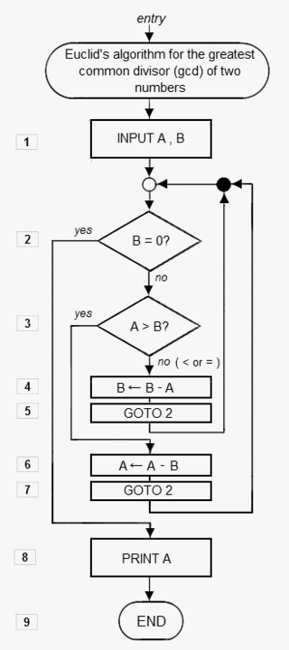
Algorithm
Procedure for solving a computational problem
Usually a finite sequence of operations
described in structured English
pseudocode or real code

Slide 8
Property of algorithm
A

Slide 9
A Good Algorithm
Correct
Fast
T(n) should increase “slowly” as n grows

Slide 10
Algorithmic time complexity T(n)
Example P: Is a certain number k in a list of n numbers?
Algorithm A1: check for each element k_{i} of the list if k_{i} = k
How much “time” (i.e. T(n)) does A1 takes?
T(n) is the exact number of steps it takes to run A1 (e.g. 1002 times, 3045 times)

Slide 11
Asymptotic complexity
The asymptotic complexity describes T(n) as n grows to infinity
In this course, we talk about THREE types of Asymptotic complexity
Θ (Theta)
O (Big O)
Ω (Omega)

Slide 12
Asymptotic complexity
Θ (Theta) means “grows asymptotically = ”
O (Big O) means “grows asymptotically <=“
Ω (Omega) means “grows asymptotically >=“

Slide 13
Asymptotic complexity
Θ (Theta) means “grows asymptotically equal ”
For example
For example
F(x) = Θ (G(x)) means “F grows as G, when x grows to infinity”

Slide 14
Asymptotic complexity
O (Big O) means “grows asymptotically <=“
For example
For example
F(x) = O(G(x)) means “F grows at most as fast as G, when x grows to infinity”

Slide 15
Asymptotic complexity
Ω (Omega) means “grows asymptotically >=“
For example
For example
F(x) = Ω (G(x)) means “F grows at least as fast as G, when x grows to infinity”

Slide 16
Quick Exercises
Hints, asymptotic increasing order (quick to slow)
log(log x), logx, x, x², x¹⁰, x⁹⁹⁹⁹⁹, 2^{x}, x^{x}

Slide 17
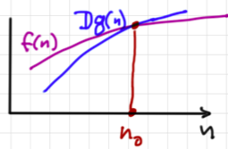
Exact definitions

Slide 18
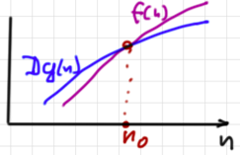
Exact definitions

Slide 19
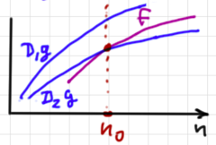
Exact definitions

Slide 20
Exact definitions

Slide 21
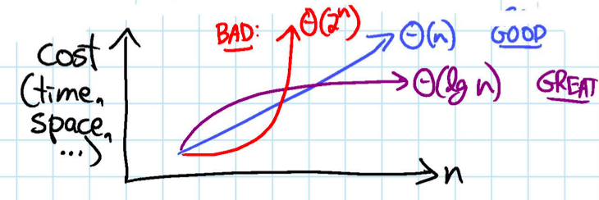
Complexity of algorithms
In simple and practical words used in the industry
Θ(logn): great algorithm
Θ(n), Θ(n logn), Θ(n²): good algorithm
Θ(n³): hard to say….
Θ(2^{n}): bad algorithm

Slide 22
Complexity of algorithms
In simple and practical words used in the industry
O(logn): great algorithm
O(n), O(n logn), O(n²): good algorithm
O(n³): hard to say….
O(2^{n}): bad algorithm
Ω(n): not much practical information there…
we seldom use Omega

Slide 23
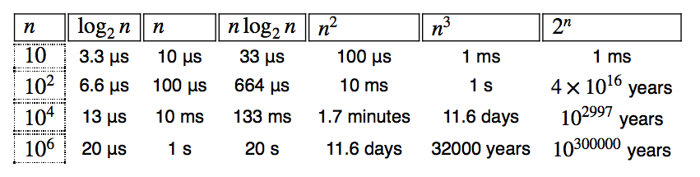
Asymptotic complexity in practice
Data Size in μs
Practically ineffective
algorithm
“Practical” Algorithm
The time needed to solve a problem

Slide 24
Conclusions
Key concepts:
Problem
Space and instance
algorithm
properties of algorithms
asymptotic complexity (Θ, O, Ω)

